Slide 1
Department of History Tarakeswar Degree College
Pre-History India
Dr. Sahidujjaman Khan
Assistant Professor
Department of History
Tarakeswar Degree College

Slide 2
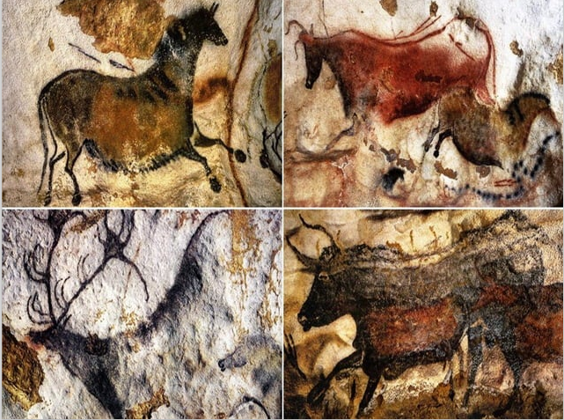
Pre History India
Cave Paintings

Slide 3
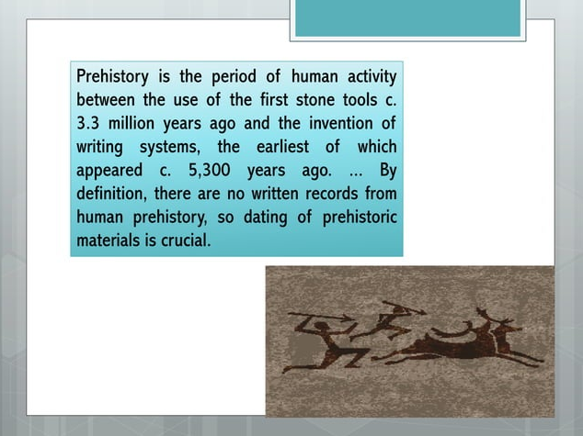
Hunting

Slide 4
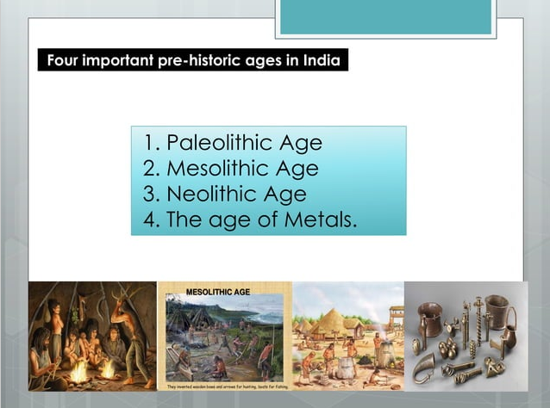
Phases of Stone Age

Slide 5
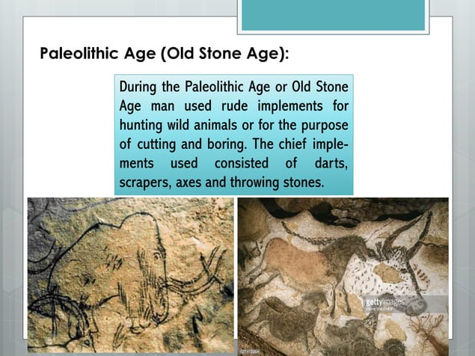

Slide 6
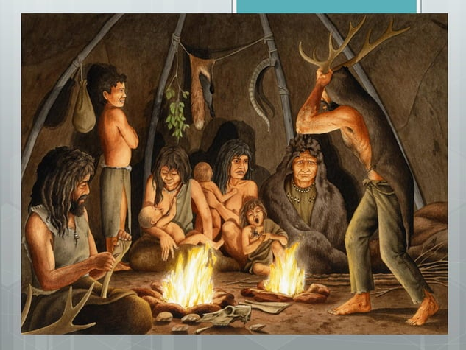
Use of Fire

Slide 7
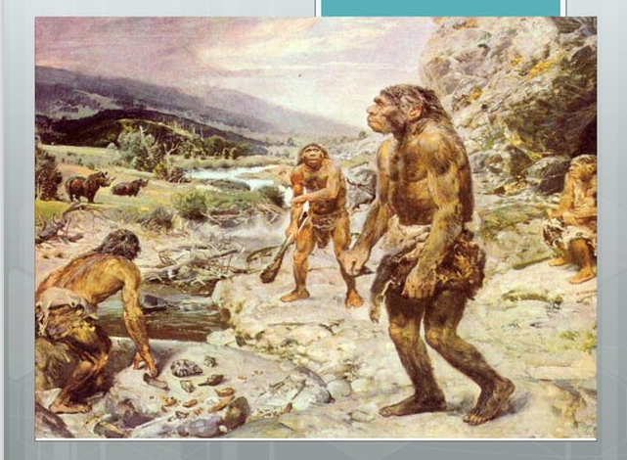
Hunting and Food Gathering

Slide 8
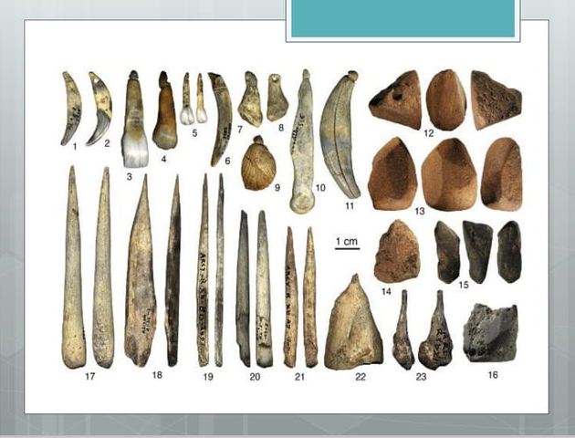
Stone Tools

Slide 9
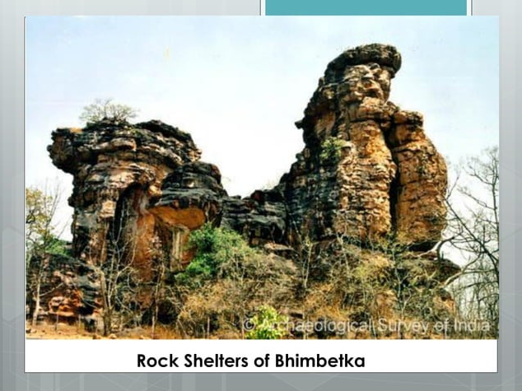
Bhimbetka Cave

Slide 10
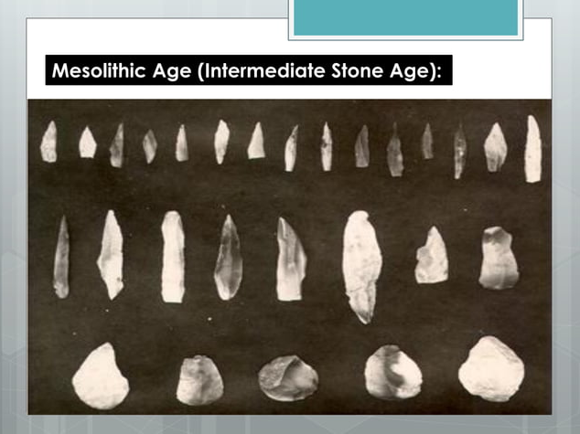
Stone Tool: Microlith

Slide 11
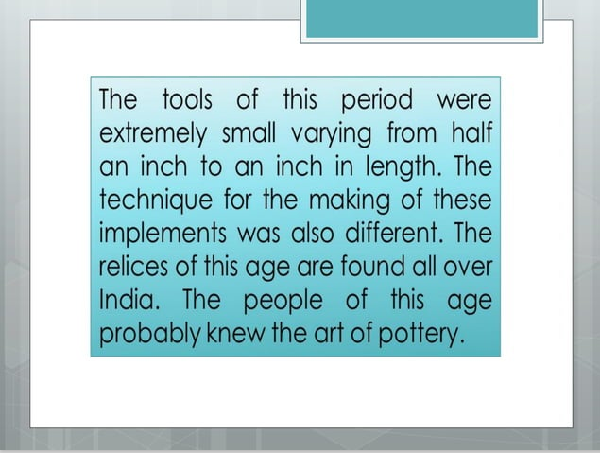
Details of Stone Tool

Slide 12
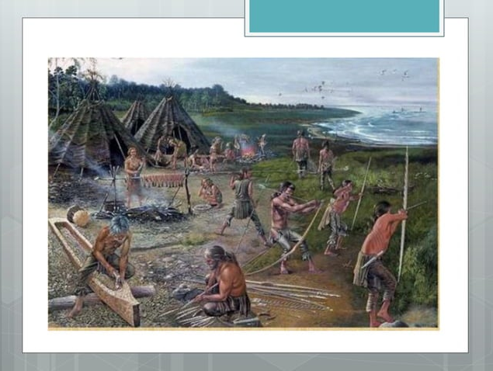
Riverside Settlement

Slide 13
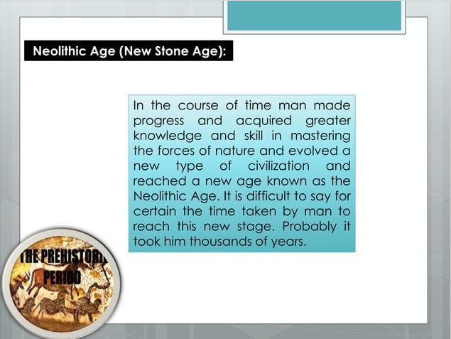

Slide 14
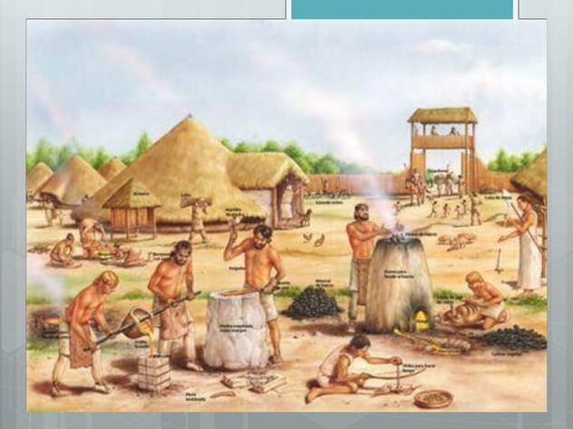
Clan to Society

Slide 15
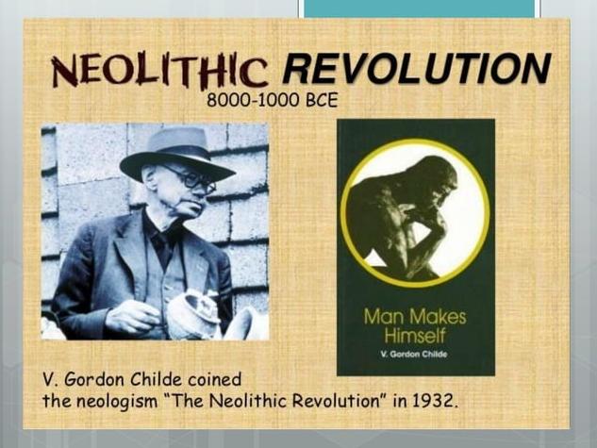

Slide 16
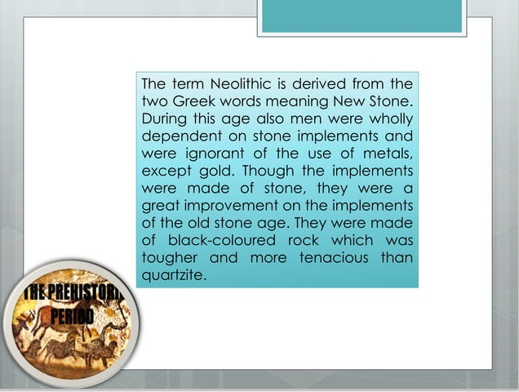
Neolithic Period

Slide 17
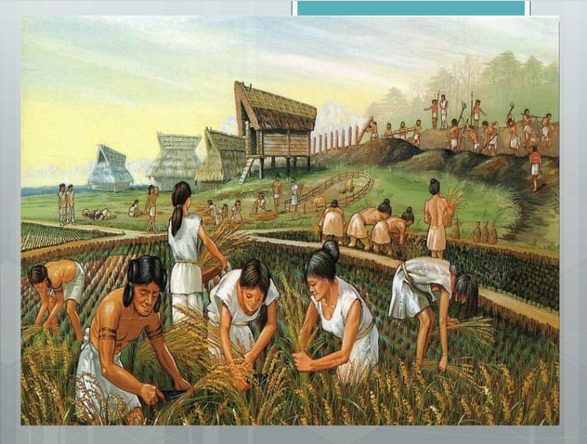
Beginning of Agriculture

Slide 18
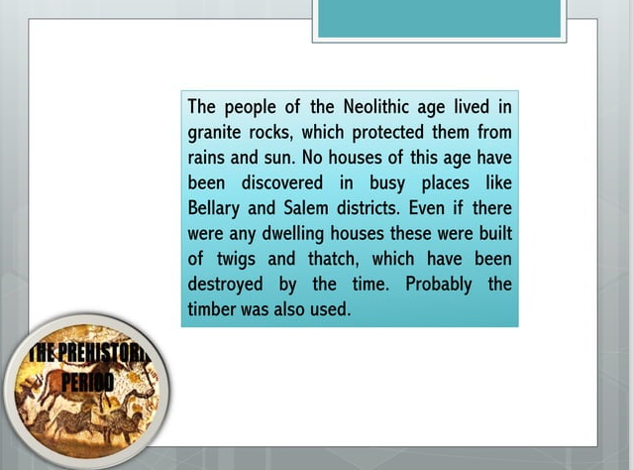
Houses in New Stone Age

Slide 19
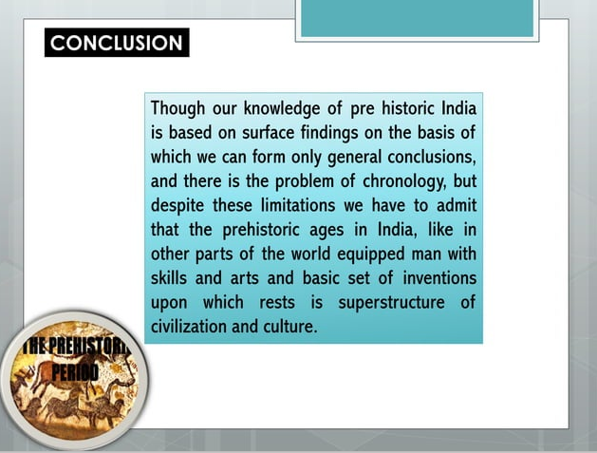
Conclusion
Pre-History India

